Slide 1





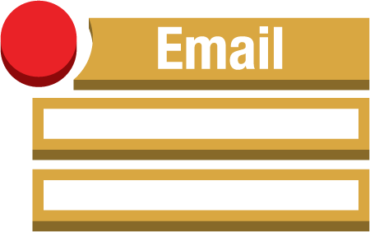



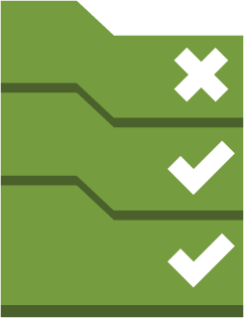
AWS-Region
S3
Cloudtrail
Delivered to CloudWatch Logs
Alarms
Amazon CloudWatch
SNS
Email Notification
Event Rules
Custom Lambda functions
Custom Config rules
Lambda functions
Config Rules
Config
Managed
Config rules

